Slide 1
Paths in Graphs

Slide 2
Paths and Connectivity

Slide 3
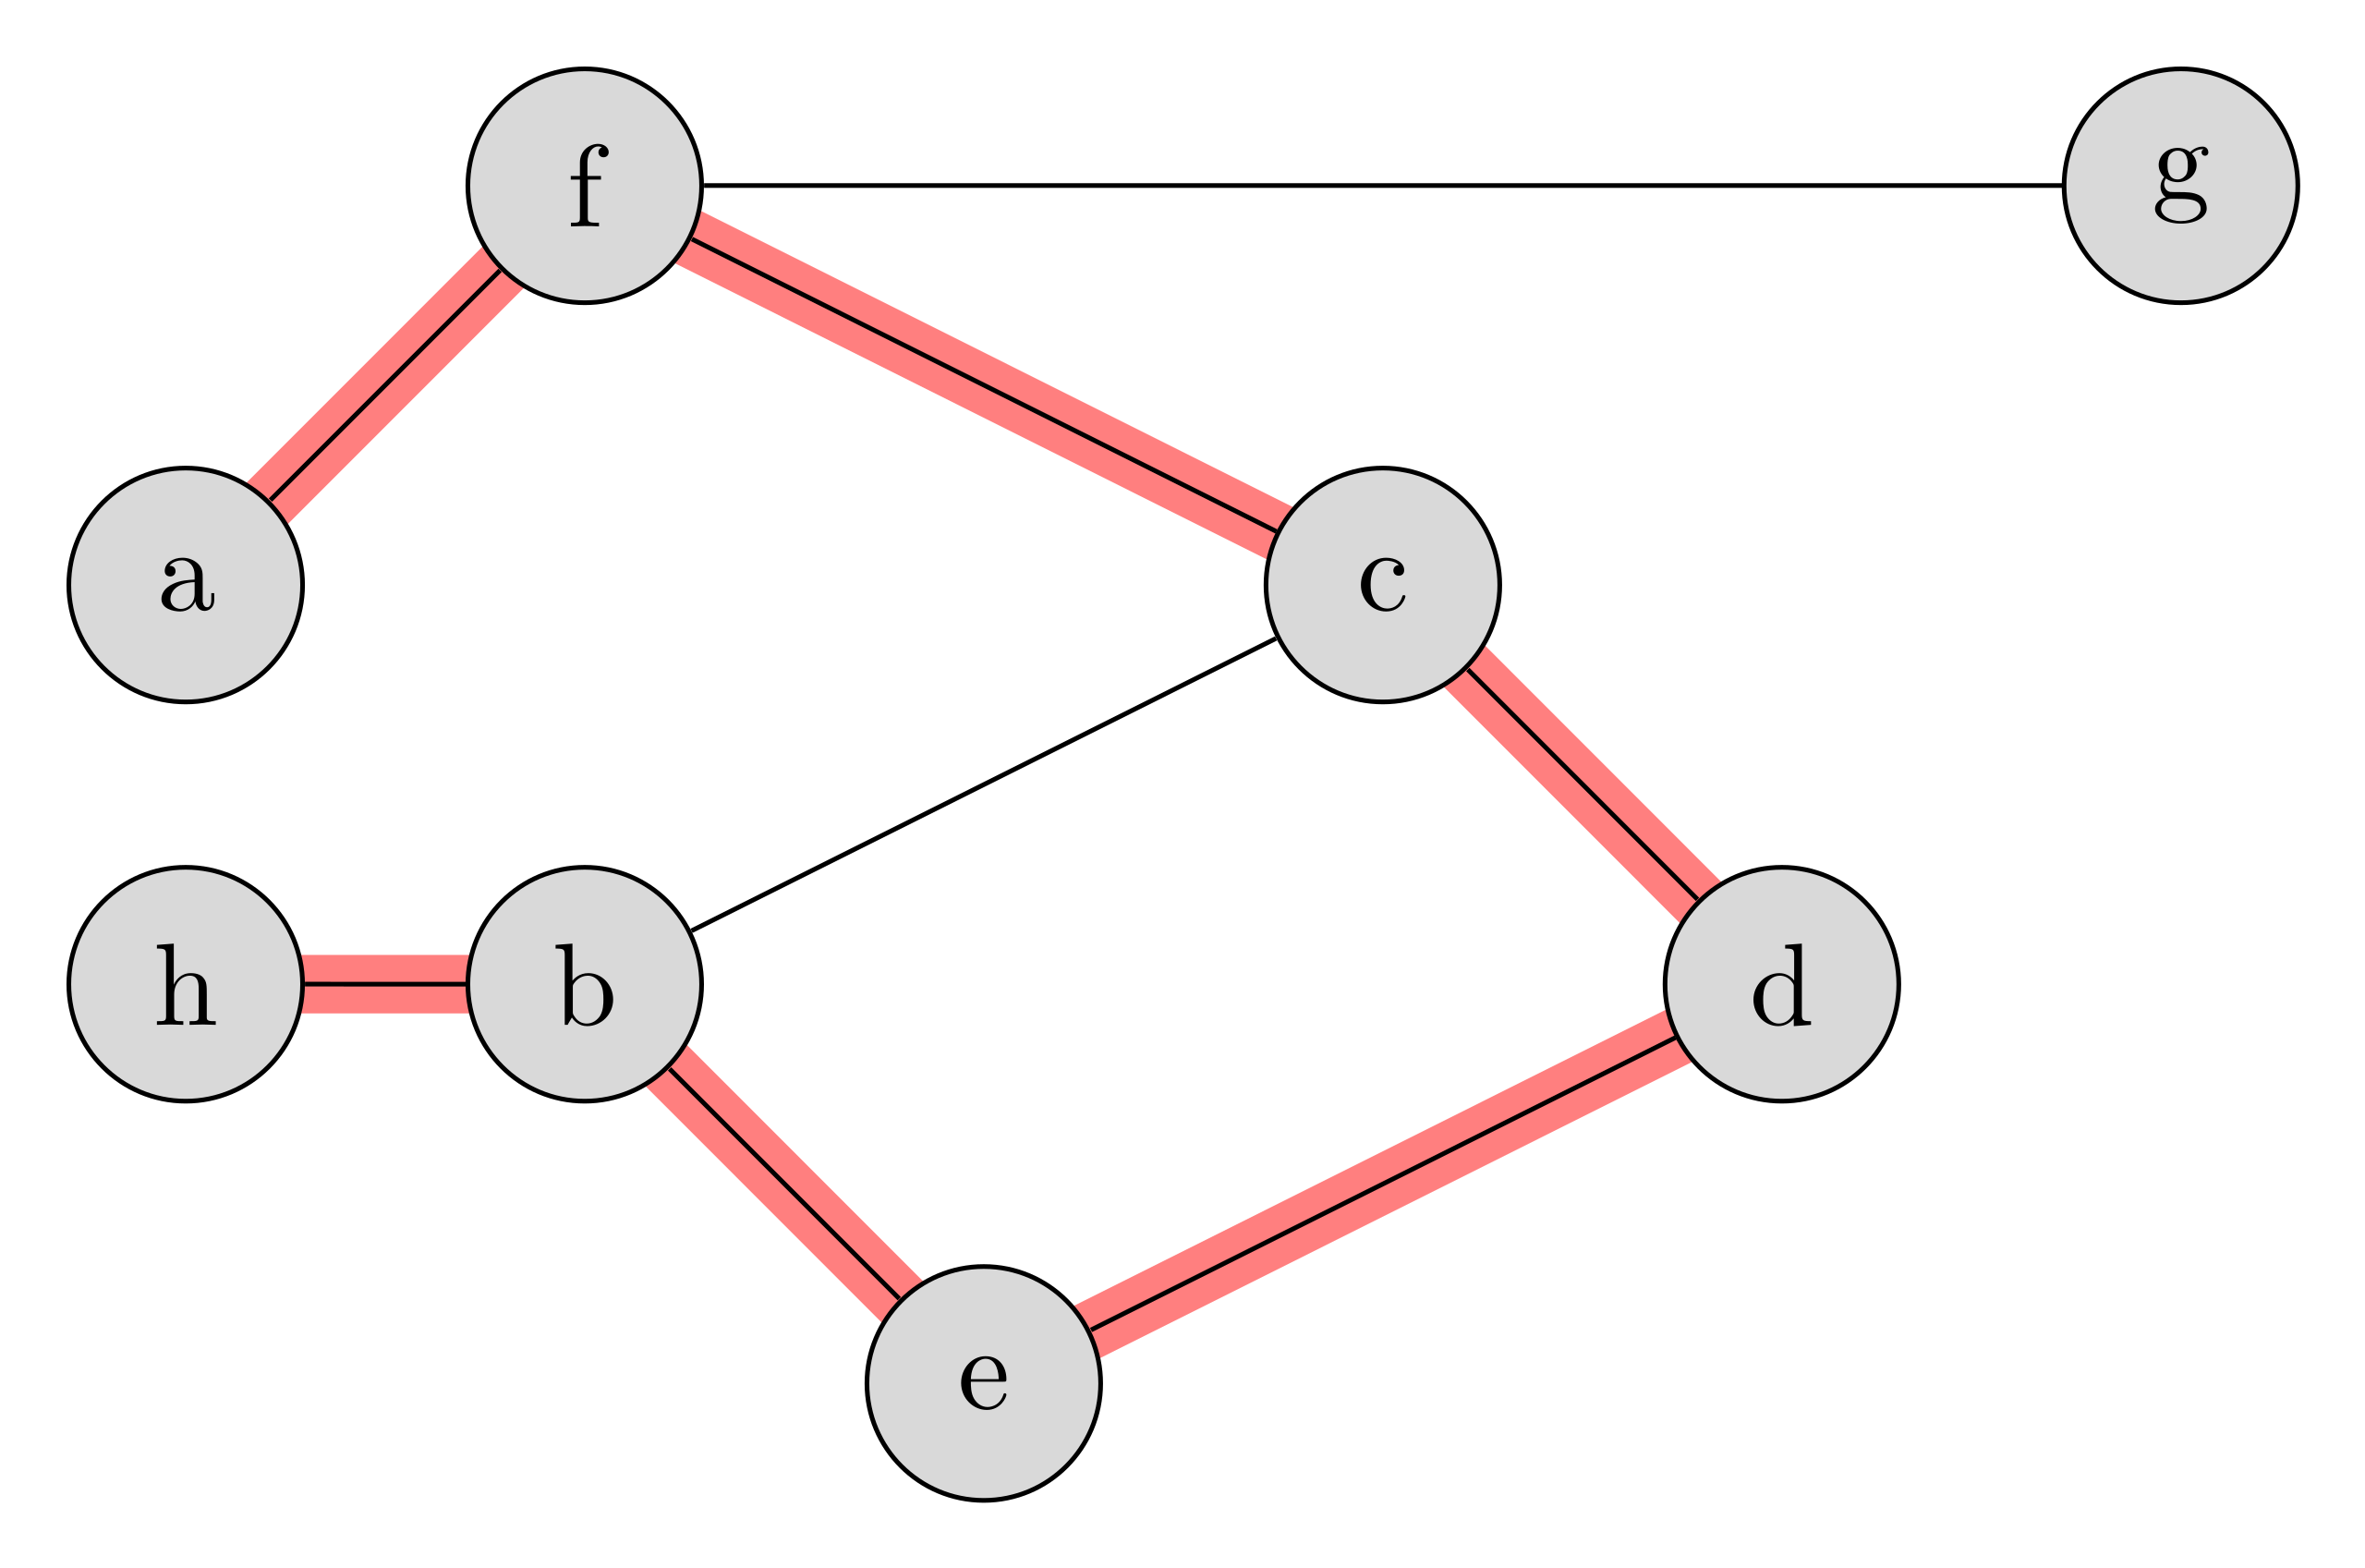

Example
a path of length $6$ between the vertices $a$ and $h$

Slide 4
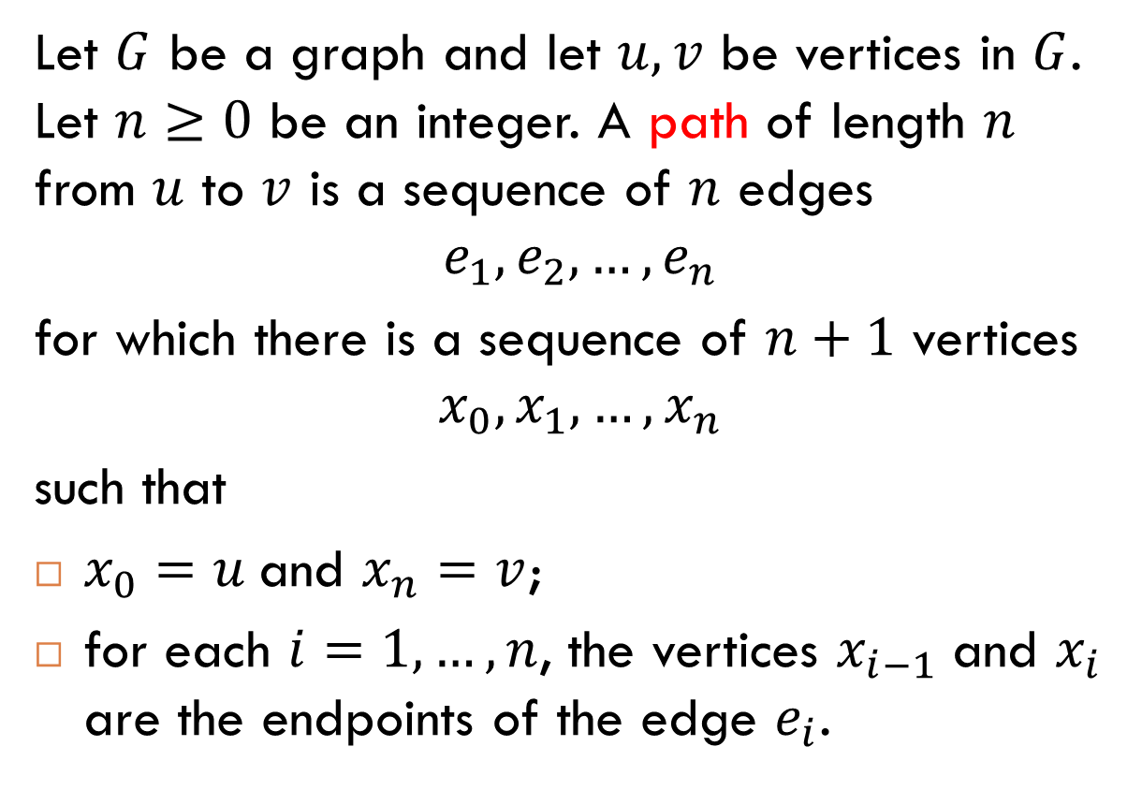
Definition
Let $G$ be a graph and let $u, v$ be vertices in $G$. Let $n≥0$ be an integer. A path of length $n$ from $u$ to $v$ is a sequence of $n$ edges
$$e_{1},e_{2},…, e_{n}$$
for which there is a sequence of $n+1$ vertices
$$x_{0}, x_{1}, …, x_{n}$$
such that
$x_{0}=u$ and $x_{n}=v$;
for each $i=1, …, n$, the vertices $x_{i−1}$ and $x_{i}$ are the endpoints of the edge $e_{i}$.
Notes:
If $G$ is a simple graph, then we can represent the path $e_{1},e_{2},…, e_{n}$, by the corresponding sequence of vertices $x_{0}, x_{1}, …, x_{n}$.

Slide 5
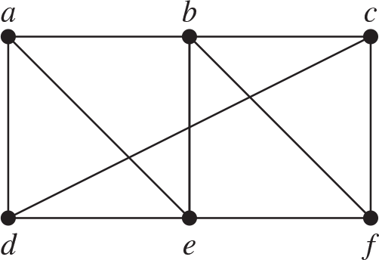

Simple Paths
Definition. A path is called simple if it does not contain the same edge more than once.
Examples
The path (that passes through the vertices) $a, d, c, f, e$ is simple.
The path $a, b, e, d, a, b$ is not simple.

Slide 6
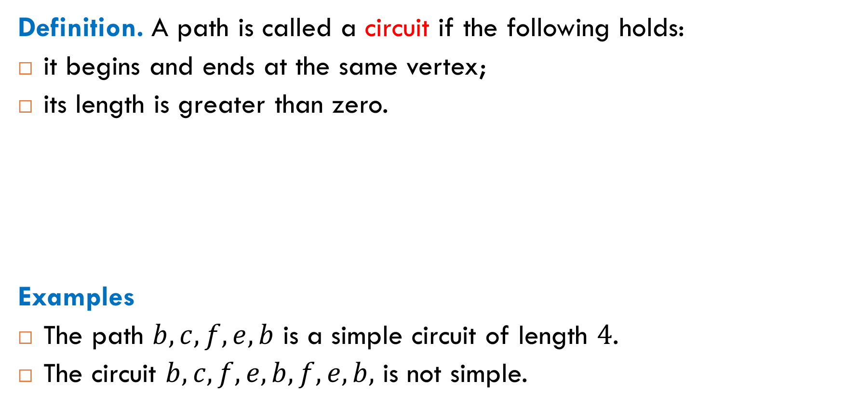
Circuits
Definition. A path is called a circuit if the following holds:
it begins and ends at the same vertex;
its length is greater than zero.
Examples
The path $b, c, f, e, b$ is a simple circuit of length $4$.
The circuit $b, c, f, e, b, f, e, b,$ is not simple.

Slide 7
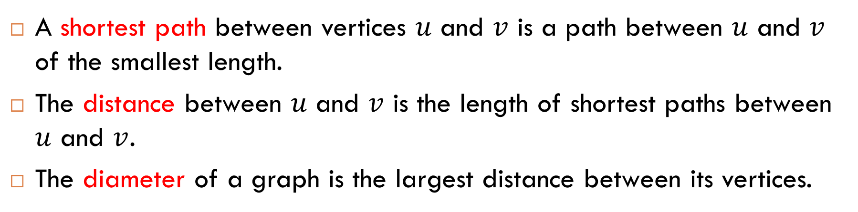

Distance and Diameter
A shortest path between vertices $u$ and $v$ is a path between $u$ and $v$ of the smallest length.
The distance between $u$ and $v$ is the length of shortest paths between $u$ and $v$.
The diameter of a graph is the largest distance between its vertices.
What is the diameter of this graph?
The diameter is $5$.

Slide 8
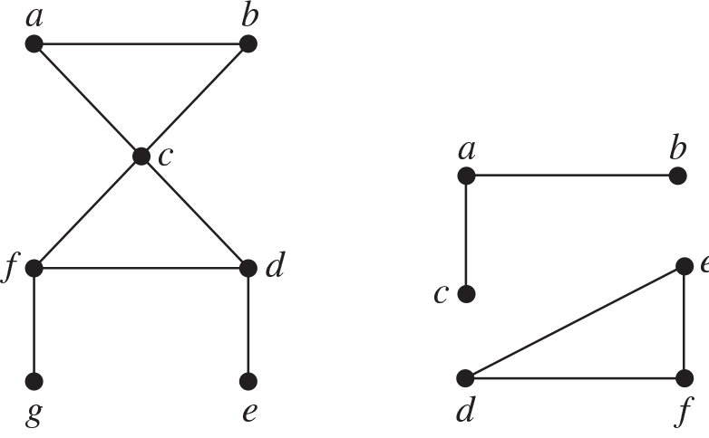

Connected Graphs
Definition. A graph $G$ is called connected if there is a path between every pair of vertices of $G$. If $G$ is not connected, it is called disconnected.
connected graph
disconnected graph

Slide 9
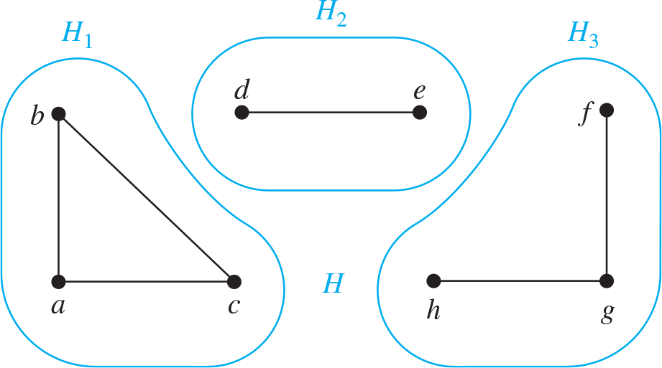

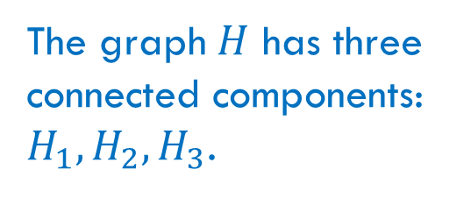
Connected Components
Definition. A connected component of a graph $G$ is a connected subgraph of $G$ that is not a proper subgraph of another connected subgraph of $G$. That is, a connected component of $G$ is a maximal connected subgraph of $G$.
The graph $H$ has three connected components: $H_{1}, H_{2}, H_{3}$.

Slide 10
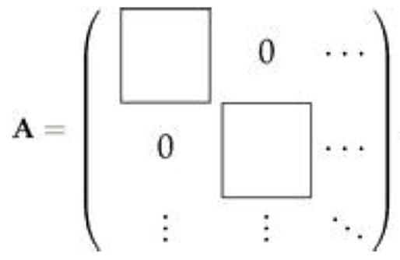

Connected Components and Adjacency Matrices
If a graph has more than one component, then its vertices can be re-labeled in such way that the adjacency matrix $A$ of the re-labeled graph has block diagonal form: all non-zero entries of $A$ are confined to square blocks along the diagonal.

Slide 11
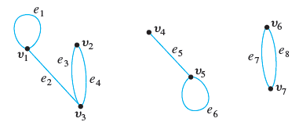
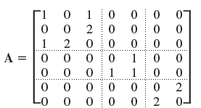
Example
Such a matrix is called a block matrix.

Slide 12
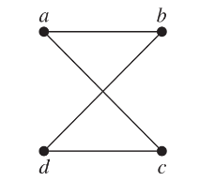
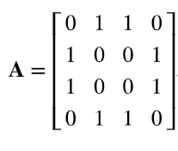
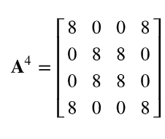

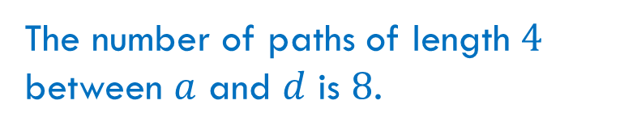
Counting the Number of Paths
Theorem. Let $G$ be a graph and $A$ be its adjacency matrix. For each pair of vertices $i$ and $j$, the number of different paths of length $r$ between $i$ and $j$ equals the $(i,j)$th entry of the matrix $A^{r}$.
Example
The number of paths of length $4$ between $a$ and $d$ is $8$.

Slide 13
Connectivity in Directed Graphs

Slide 14
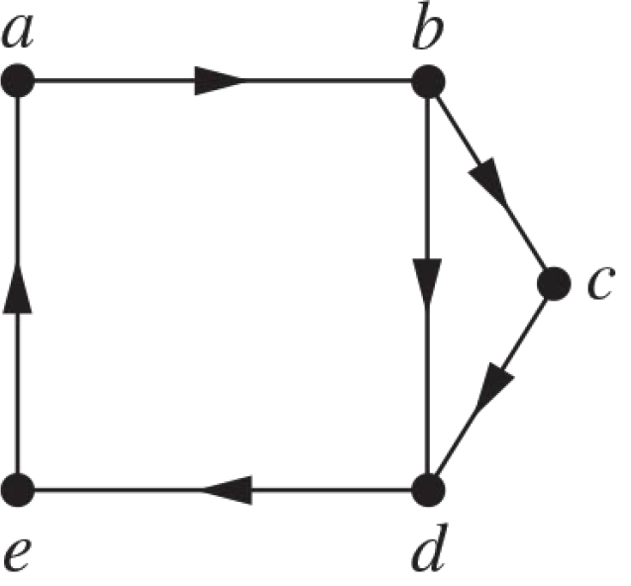
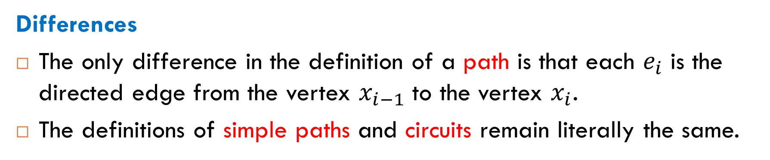
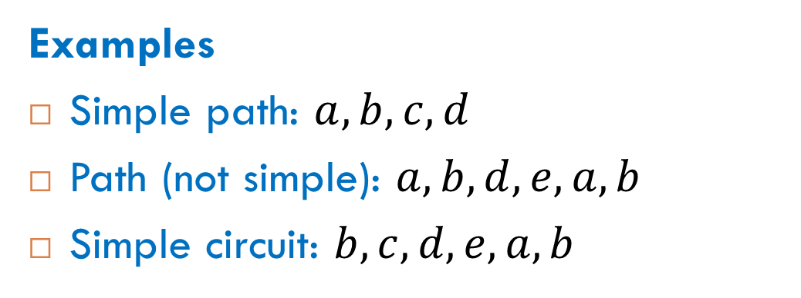
Definitions for Directed Graphs
Differences
The only difference in the definition of a path is that each $e_{i}$ is the directed edge from the vertex $x_{i−1}$ to the vertex $x_{i}$.
The definitions of simple paths and circuits remain literally the same.
Examples
Simple path: $a, b, c, d$
Path (not simple): $a, b, d, e, a, b$
Simple circuit: $b, c, d, e, a, b$

Slide 15
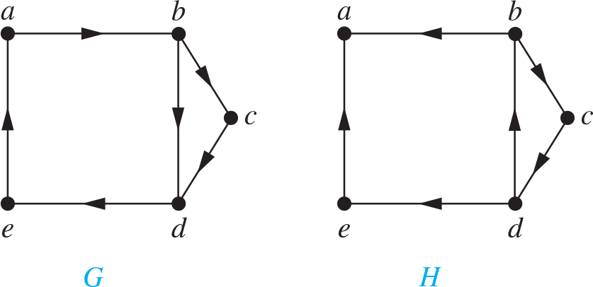



Connectedness in Directed Graphs
Definition. A directed graph $G$ is called strongly connected if for each pair of vertices $u$ and $v$,
there is a path from $u$ to $v$;
there is a path from $v$ to $u$.
$G$ is strongly connected
$H$ is not strongly connected

Slide 16
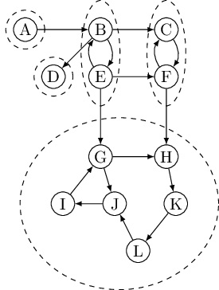
Strongly Connected Components

Slide 17

Reading
Sections 6.11-6.12

